Slide 1

Research Billing in EPIC
May 1, 2024
Brianne Voros, MS, CCRP
Email: bvoros@lsuhsc.edu

Slide 2
Objectives
Discuss the importance of the MCA in the context of Research Billing Compliance
Review Linking to Research Studies in Epic
Describe the process for Research Billing Review in Epic

Slide 3
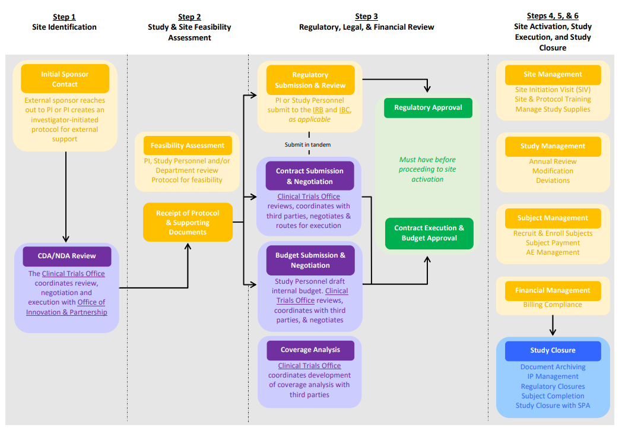
Lifecycle of a Clinical Trial

Slide 4
Components of Research Billing in EPIC
Medicare Coverage Analysis (MCA)
Standard of Care Processes that affect Research Billing Compliance
Linking to Research Study in EPIC
Research Billing Review

Slide 5
What is a Medicare Coverage Analysis?
Analysis required for all clinical trials involving tests, procedures, and interventions associated with a clinical trial that are invoiced to third party payers (i.e., Sponsors) to determine what costs, if any, can be covered by Medicare.
The MCA is one of the most useful documents for building a clinical trial budget and ensuring clinical trial billing compliance.
LSUHSC CTO Training - Medicare Coverage Analysis for Clinical Research

Slide 6
Understanding the MCA
…and Why It Is IMPORTANT
The Principal Investigator (PI) has the ultimate responsibility for achieving research billing compliance….. but the full support of the study team is needed to do so successfully.
The PI has primary responsibility to understand and comply with rules for billing Medicare, Medicaid and third-party payors for services, drugs, devices, tests and procedures rendered in the clinical research context.
Other site personnel (including patient service representatives, billers, coders, clinic administrators, etc.) are responsible for working with the Principal Investigator and study team to ensure that services for patients enrolled in research studies are scheduled, coded, billed and documented appropriately.

Slide 7
Risks Associated with Research Billing Non-Compliance
Billing for services that are already paid by the sponsor (double billing)
Billing for services promised free in the informed consent
Billing for services that are for research‐purposes only
Billing for services that are part of a non‐qualifying clinical trial and do not qualify for coverage

Slide 8
Federal False Claims Act
Federal False Claims Act (FCA) establishes liability for anyone who submits a false claim for payment to the government
  Specific intent not required
  False Claims Act applies to clinical research activities and failure to comply with the rules may lead to fines and penalties
  Under the False Claims Act, those who knowingly submit, or cause another person or entity to submit false claims for payment of government funds, are liable for three times the government’s damages plus civil penalties of $10,781 to $21,563 per false claim.
Study documents and MCA must be aligned to assure compliance with clinical trial billing rules and the regulations that protect human subjects

Slide 9
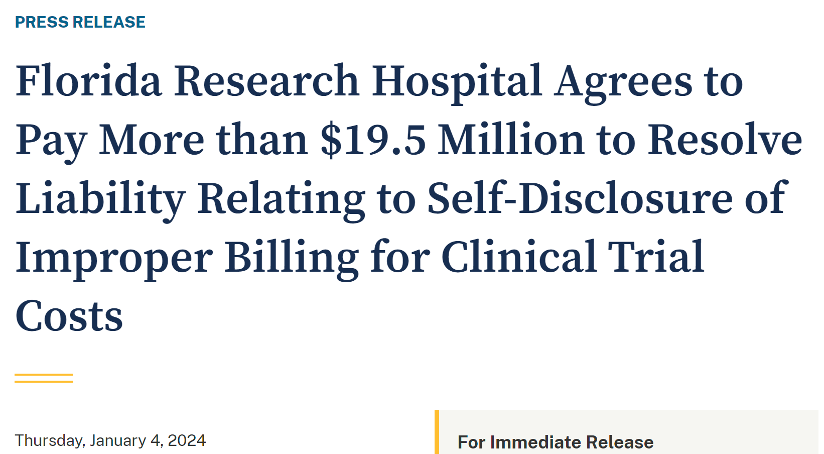
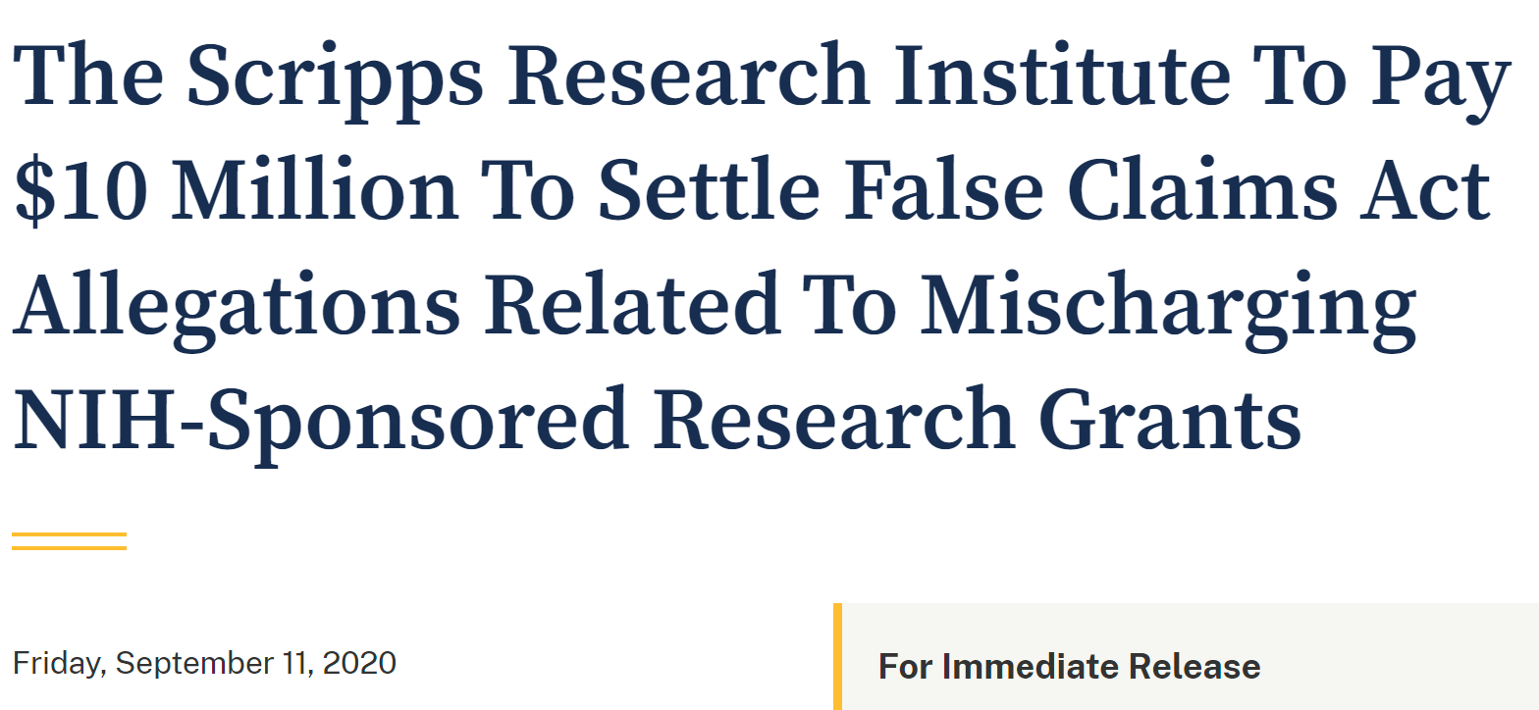

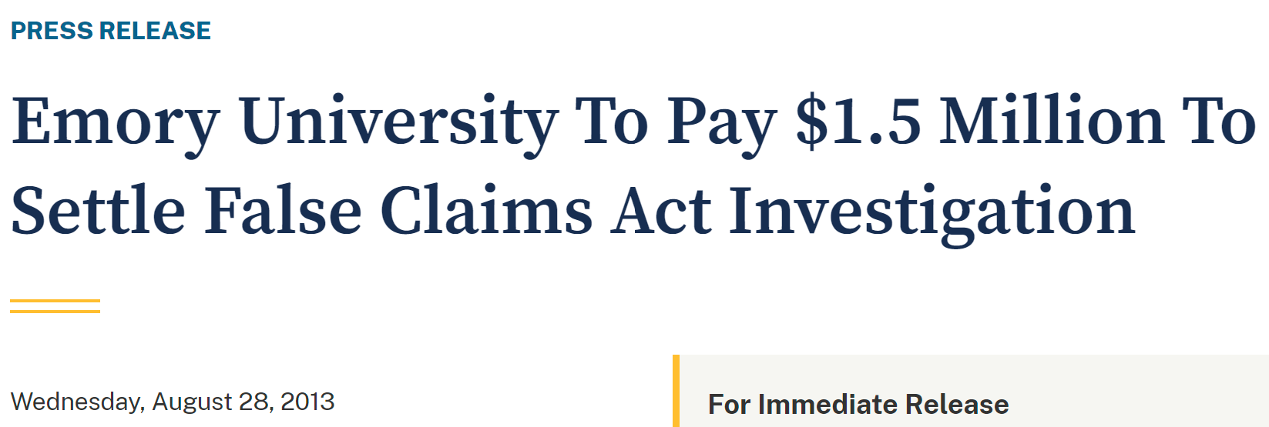
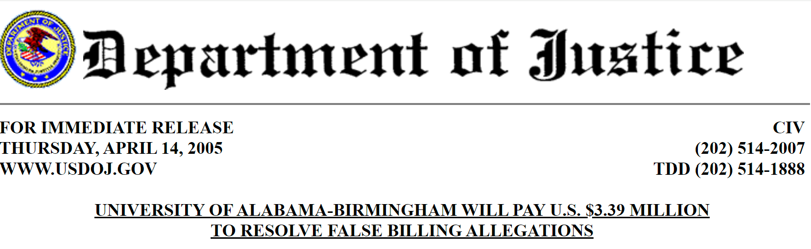
For Immediate Release….
Research Billing Non-Compliance in the Headlines

Slide 10
The 3 C’s of Research Billing Compliance
Coordination of study information across multiple study documents
Communication of relevant study information to the billing process
Cooperation among departments and offices that may not usually work together

Slide 11
The 3 C’s of Research Billing Compliance
Information that must be coordinated and communicated to minimize compliance risks
  What is billable and not billable
  Who is enrolled in a research study
  Which services are required by the protocol
Within an academic medical setting, many different parties are involved in developing study documents that have important information for billing:
  University/Campus
  School of Medicine
  Medical Center
  Physician Offices
  Sub-contractors/Private Physician Groups

Slide 12
The PI and SC should be the Protocol
EXPERTS for Non-Study Staff
MCA
Protocol
Principal investigator
DOCUMENTATION
Orders per Study Protocol
Radiology
Study Coordinator
Scheduling & Authorizations
Pharmacy
Scheduling & Authorizations
Scheduling & Authorizations
Cardiology
Clinic
Scheduling & Authorizations
Scheduling & Authorizations
Surgery
Infusion Center

Slide 13
The MCA is our cheat sheet to
WHO pays WHAT
Research Billing Terms & Definitions
Study related: A service/procedure that must happen for a research study and occurs after the subject has signed the research consent.
  Study-related services may bill to insurance (designated as M on the MCA)
Routine Care Costs aka Standard of Care: A study-related service that also happens as part of a subject’s standard medical care and is not promised free from the sponsor is designated as M on the MCA. M services bill to insurance.
  These costs may include doctor visits, hospital stays, and lab and imaging tests.
Research Sponsored (S): A study-related service that only happens for research, or is promised free from the sponsor (even if it is part of a subject’s standard medical care) will be designated as S on the MCA. S services must bill to the sponsor.
  These costs may include the investigational intervention (such as the drug being tested), extra doctor visits, electrocardiograms or blood draws, certain lab and imaging tests, and questionnaires performed solely for research purposes.

Slide 14
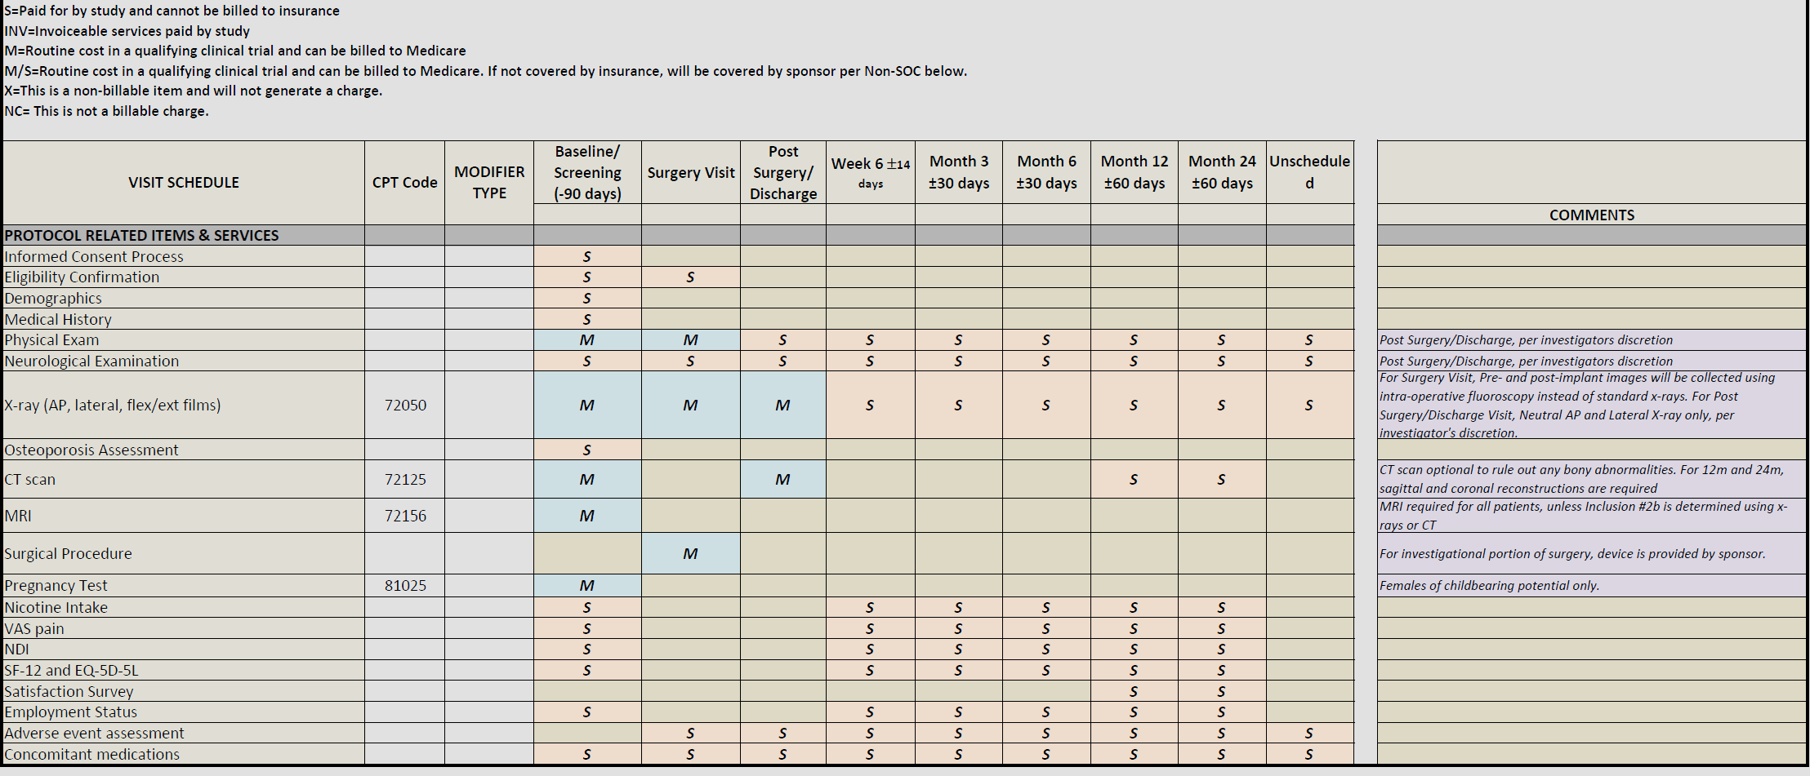
MCAs can be simple and easy to understand ….

Slide 15
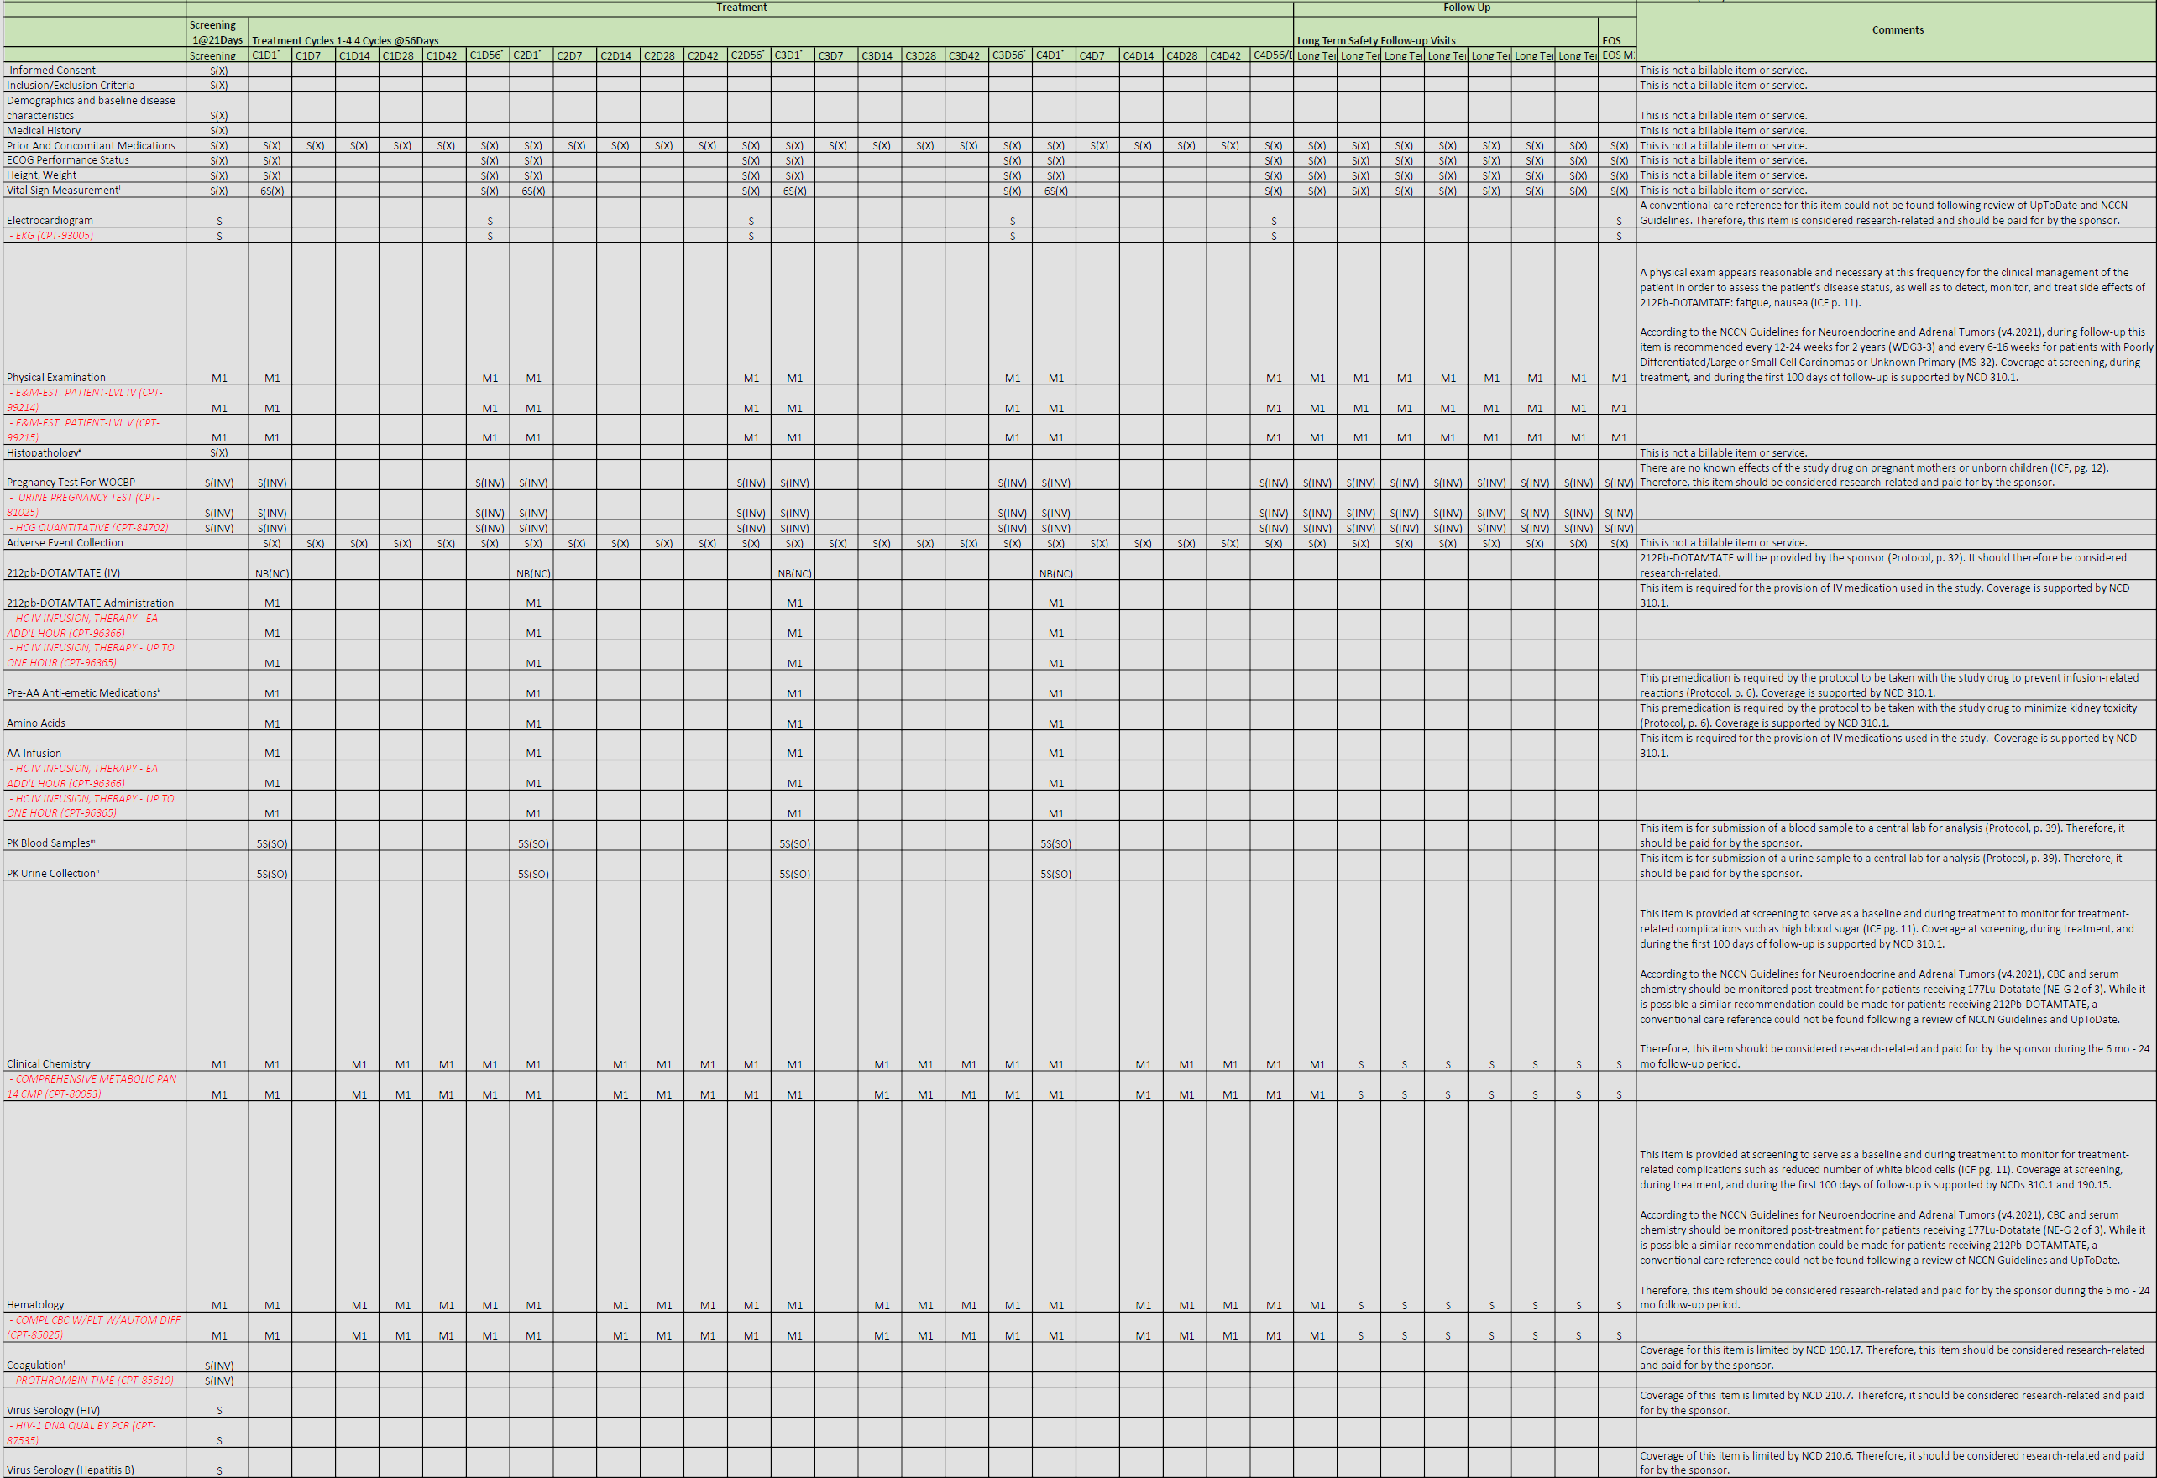
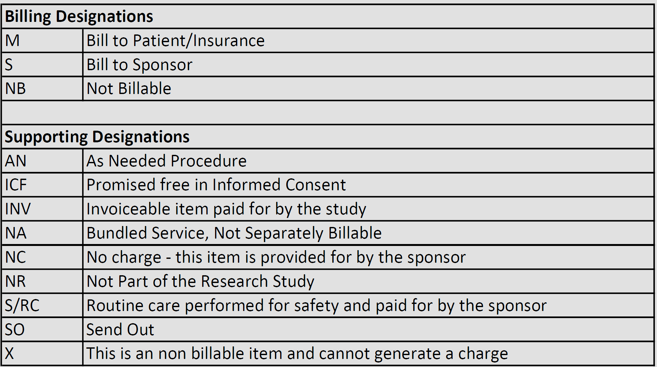
…or MCAs can be very complex

Slide 16
Lessons Learned
Never assume that RESEARCH means that everything required by the protocol is FREE
Let the normal processes that are currently in place for non-research patients continue to function for your research patients (i.e. prior authorizations, scheduling, etc.)
Utilize the current workflows of the clinic/hospital/support staff to implement the clinical trial.

Slide 17
How do we IDENTIFY Patients in EPIC as Enrolled in Research?

Slide 18
Linking Patient to the Research Study
Click on the Research Studies button in the main toolbar.
Search for and select your patient to open their chart.
Within the Research Studies activity, search for the study in the Add study search field.

Slide 19
Linking Patient to the Research Study
Search for and select an active association status, such as In Screening, Consented, or one of the Enrolled options. Once selected, the Status Effective Date will auto populate with today’s date. If you need to back chart (chart for events that happened in the past), change the Status Effective Date and the Active Start Date will automatically adjust.
Enter a participant ID if the patient’s name is not used in the study and only an ID number.
Click Accept to save your changes.

Slide 20
Research Association Status Definitions
Pre-Consent
After Consent
Identified subject is identified as meeting prescreening criteria but has not been approached
Interested subject has been approached to participate but has not signed consent form
Declined subject is not interested in participating
In Screening subject has consented to participate but has not completed screening phase
Consented subject has consented to participate but has not started treatment
Enrolled – Treatment Phase subject is on active treatment
Enrolled – Follow Up Phase subject is still on trial but has completed treatment phase and in follow up
Withdrawn
Completed subject has completed all study visits and is no longer enrolled in trial

Slide 21
Linking Patient to the Research Study
8
Notice a Research Participant banner will appear on the Storyboard. This will alert every provider that views the chart of the patient’s participation in a research study.
You will be able to click on Participant Details hyperlink to view the study report, which will display study details, linked encounters and linked orders

Slide 22
Link Encounter to Study When in an Encounter
Click on the Research Studies button in the main toolbar.
Search for and select your patient to open their chart.
Within the Research Studies activity, search for the study in the Add study search field.

Slide 23
Link Upcoming Visits to Studies via Appointment Desk
Click Appts on your main toolbar.
Look up your patient and click Accept.
Right-click the upcoming appointment.
Select Link to Research Study to confirm association or to link the appointment to the research study.
Click Close when all updates for the encounter are complete.

Slide 24
Link Upcoming Visits to Studies via Appointment Desk

Slide 25

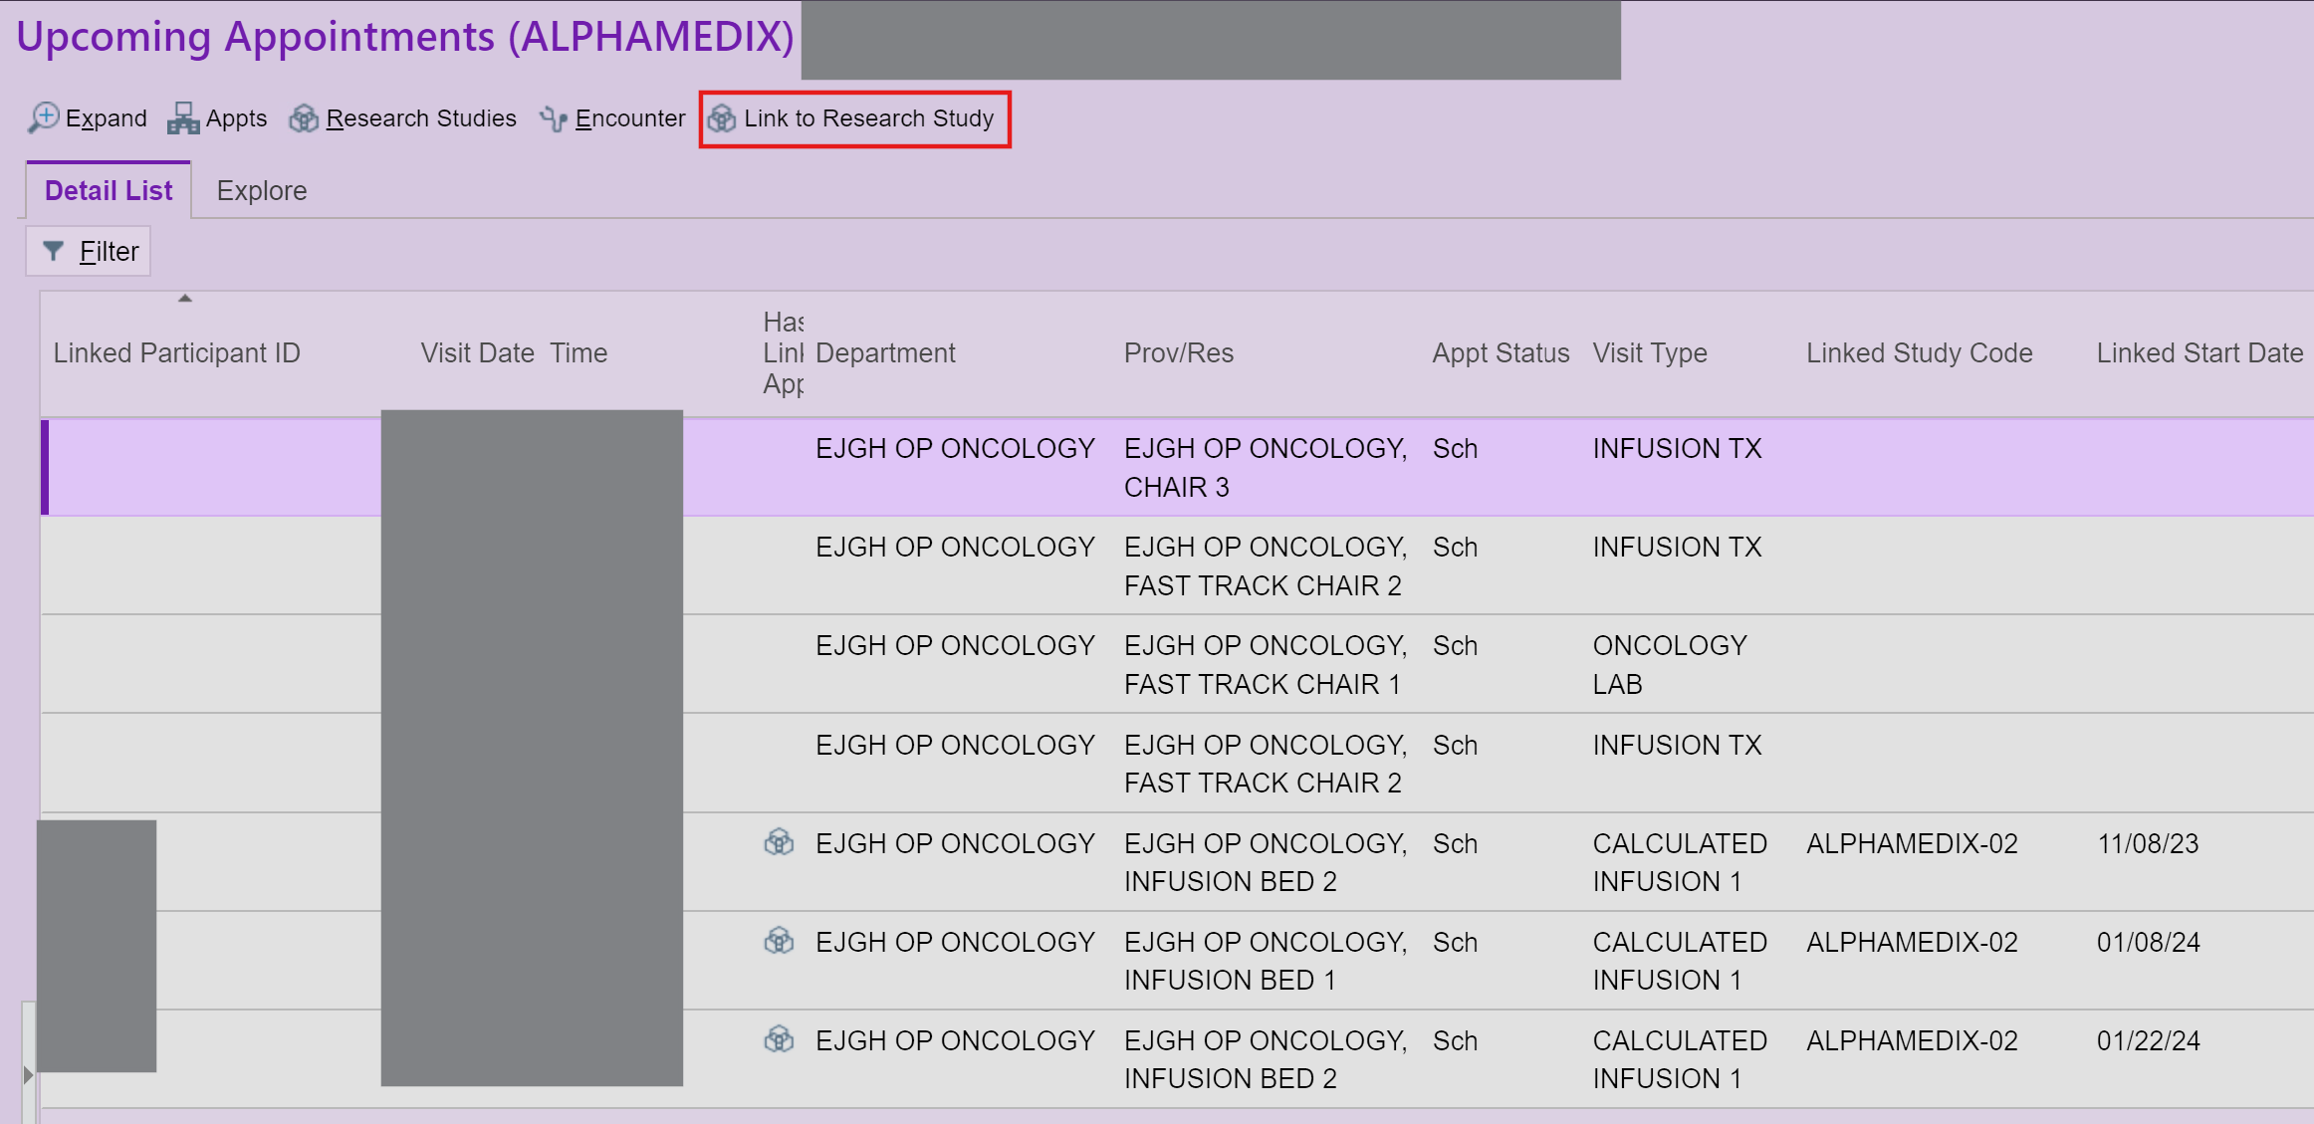
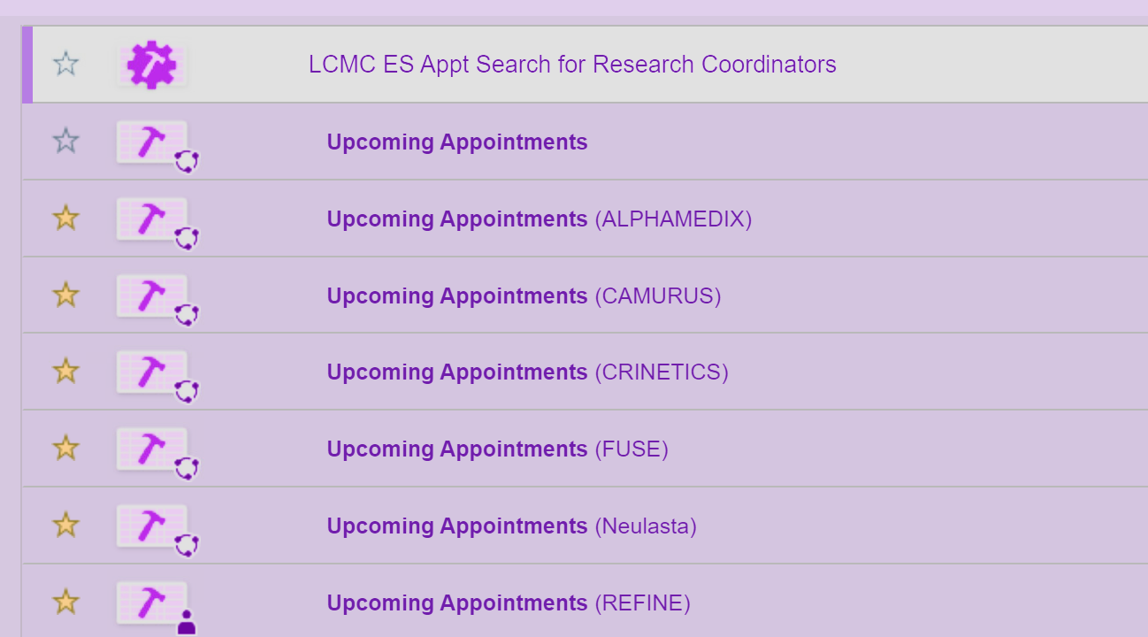
Reports for Linking Upcoming Visits to Studies
Search in Reporting Workbench for LCMC ES Appt Search for Research Coodinators.
Modify report with Study Code and Save Report as Favorite.
Select visits to be linked and Click Link to Research Study.
Can be used to link Past or Upcoming Appointments
Reach out to me if you need additional guidance on setting these up.

Slide 26
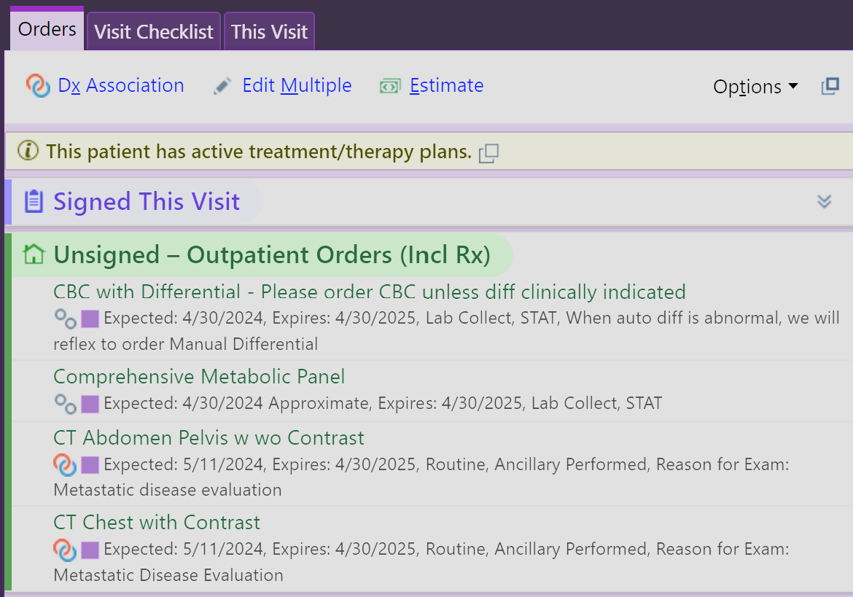
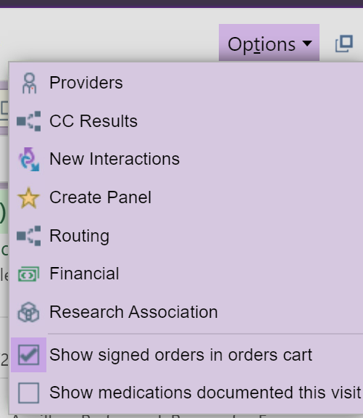
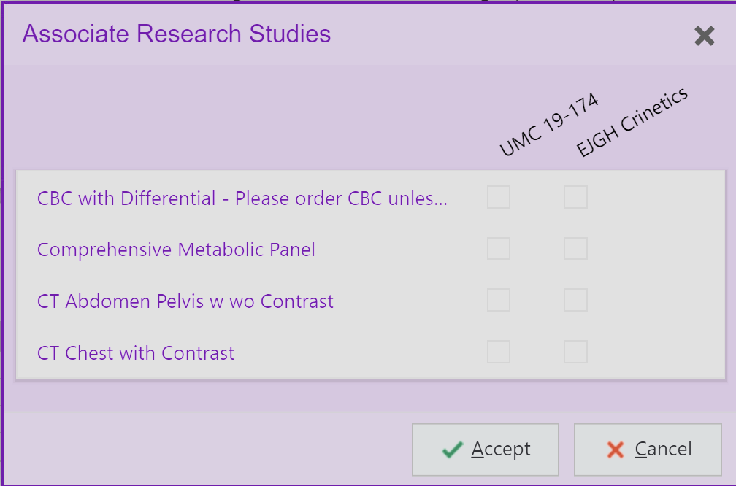
Linking Orders to Research Study When in an Encounter
At the top of the Orders Panel, select Options.
Then Click Research Association.
In pop up, Select the check box next to the Order to Associate under the applicable study.

Slide 27
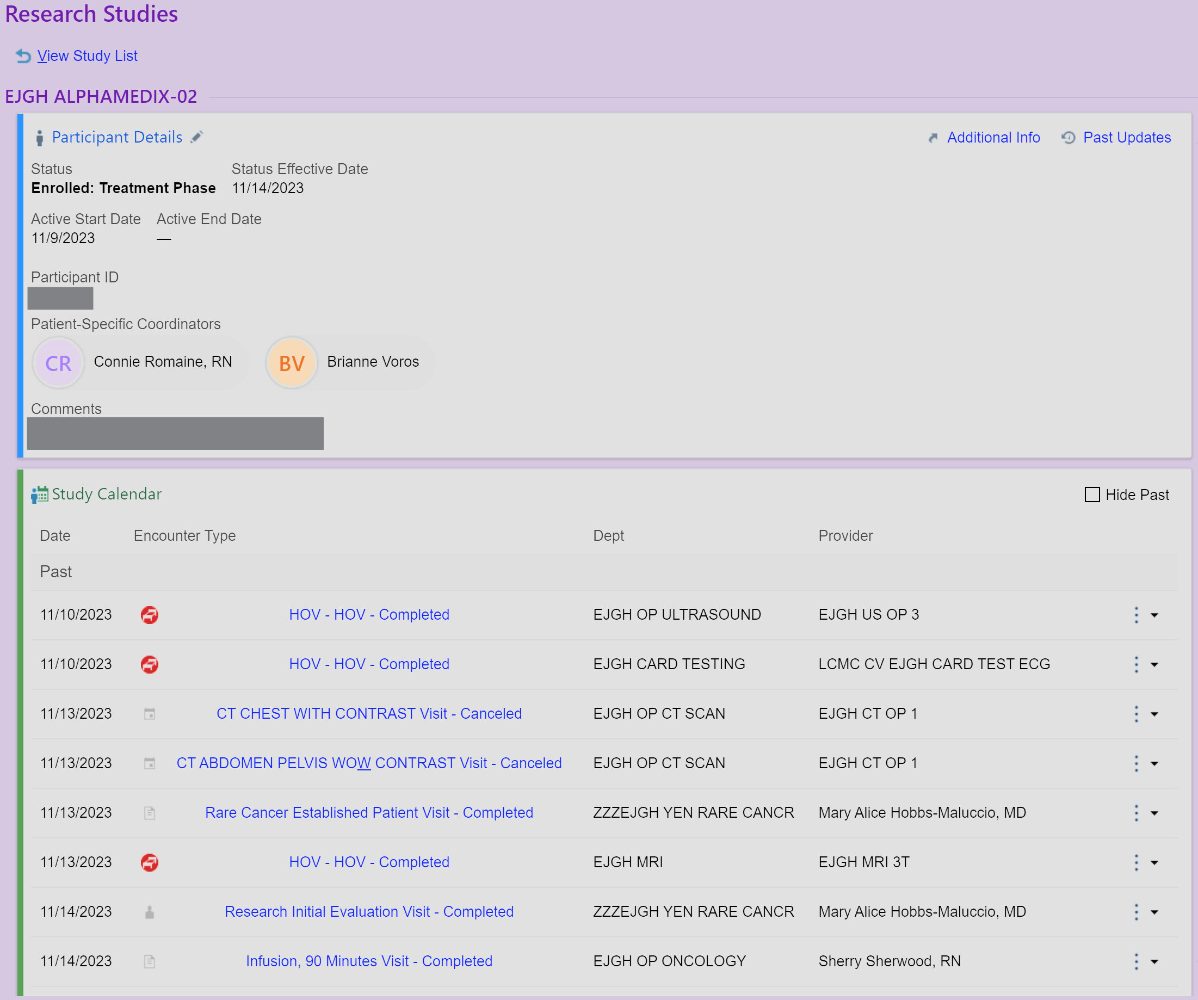
Linking Patient to the Research Study
8
8
Once linking begins, you will be able to click on the Participant Details hyperlink to view the study report, which will display study details, linked encounters and linked orders in the Study Calendar.

Slide 28
Professional Billing Charges
Currently, Professional Billing Charges are billed outside of Epic through ACS (in most cases)
Therefore, these charges are not captured in Epic. Because these charges may be reimbursed by the sponsor, some important safeguards are required to flag research patients when the billing report is sent to ACS.
This can be accomplished with the diagnosis code
Z00.6: Examination of participant in clinical trial
This will FLAG the patient as enrolled in a clinical trial and prompt ACS to reach out to the Study Coordinator.

Slide 29
CMS – Z00.6 and Q0/Q1 Modifiers
CMS requires that the following diagnosis code be used on Medicare research claims to identify Medicare patients who are participating in a Qualifying Trial:
  Diagnosis code Z00.6: Examination of participant in clinical trial
In addition, the claims must include one of the following modifiers to differentiate between routine and investigational clinical services:
  Q0 – Investigational clinical service provided in a clinical research study that is in an approved clinical research study.
  Q1 – Routine clinical service provided in a clinical research study that is in an approved clinical research study.

Slide 30
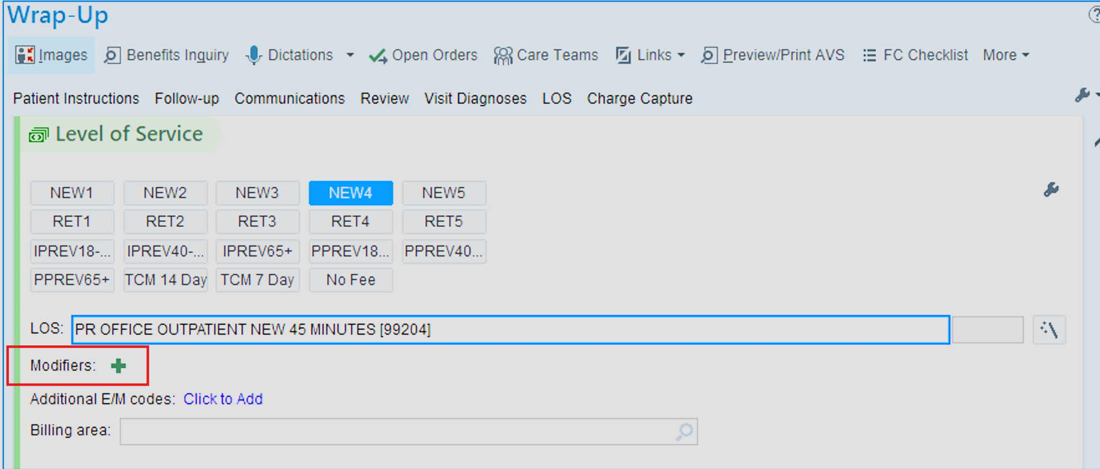
Coding Office Visits with Modifiers
  Q0 – Investigational clinical service provided in a clinical research study that is in an approved clinical research study.
  Q1 – Routine clinical service provided in a clinical research study that is in an approved clinical research study.

Slide 31
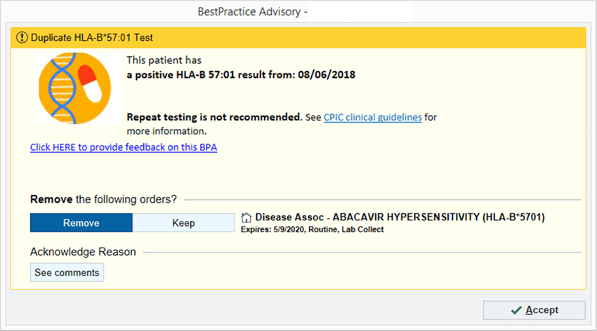
Best Practice
DID YOU ADD Z00.6 TO YOUR VISIT DIAGNOSES?
This patient is
enrolled in a clinical trial.
Please consider:
Linking patient to research study
Ensuring that all orders are linked to the research study before signing visit.
Check with your Study Coordinator ☺

Slide 32
Putting it ALL together

Slide 33
Research Billing Review Process
All charges linked to patients enrolled in a research study in Epic are flagged and reviewed to make sure they're billed appropriately through the Research Billing Review Process.
Each charge associated with a research patient falls into one of three buckets:
Non-research related. These charges are billed to the patient or their insurance.
Research-related, bill to the study. These are research charges that will be billed to the study or study sponsor.
Research-related, bill to the patient. These are research-related charges that are billed to and paid by the patient or their insurance.

Slide 34
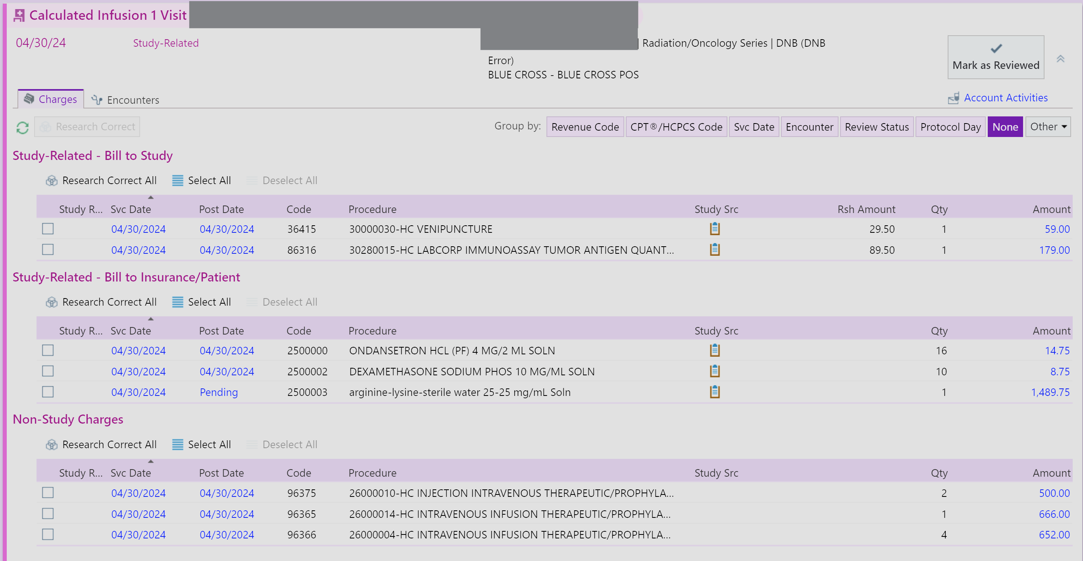
Research Billing Review Process

Slide 35
Important Takeaways
Understanding the MCA is the foundation of ensuring compliant research billing
Linking Patients, Orders, and Encounters on the front end saves a headache on the backend
Communication with all involved is KEY
Add Z00.6 diagnosis code with Q0/Q1 modifiers
Research Billing Non-Compliance jeopardizes our ability to continue doing research. We must work together to ensure that it is done correctly!

Slide 36
Resources
LSUHSC CTO Training - Medicare Coverage Analysis for Clinical Research
CITI Training - Clinical Trial Billing Compliance
CMS.gov National Coverage Determination (NCD) - Routine Costs in Clinical Trials
HCPCS Modifiers when Billing for Patient Care in Clinical Research Studies

Slide 37


